Slide 1
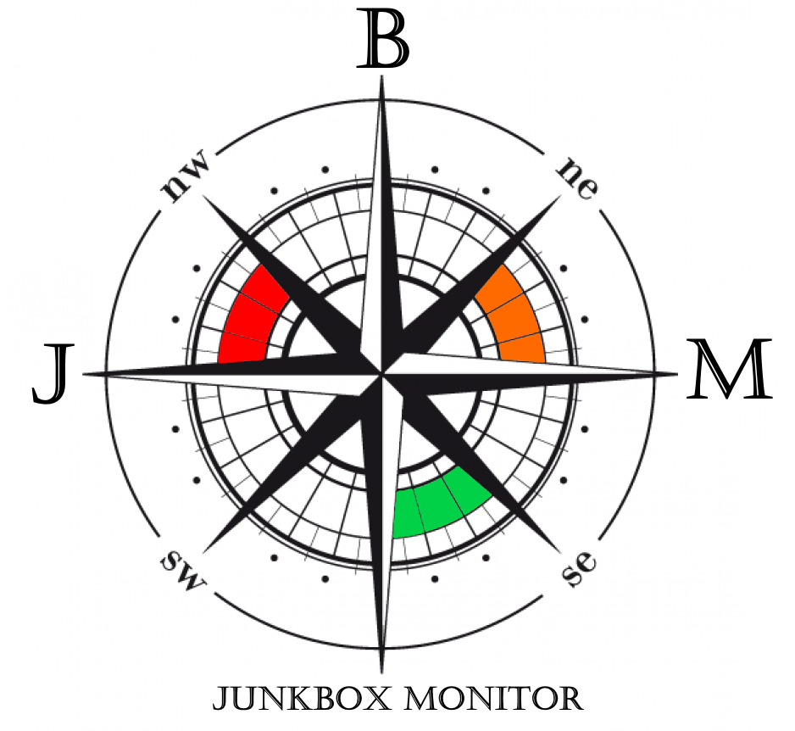
Junkbox Monitor
Give visibility to your deliverability
Blacklists
Whitelists
Seed list Email content
Inbox / folder / tab
placement
Postmaster & router KPIs
And much more…

Slide 2
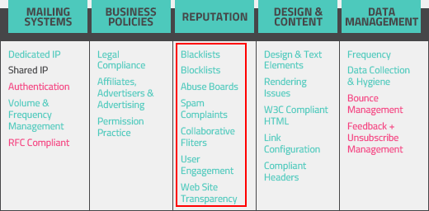
Reputation:
pillar of successful email deliverability
Retrieve
Measure
JBM gets indicators several times a day
. Adobe campaign, IBM, Sendgrid, Mandrill, Smartfocus, Sendinblue, Sparkpost, Emarsys KPIs
. Signal spam (optional) . Trendmicro . Spamassassin
. Blacklists / whitelists (IPs/domains)
. Microsoft / Gmail / Mail.ru / Yandex reputation . Gmail reputation
. And much more…
It complets your usual KPIs : opens, clicks, reactivity, soft/hard bounces…

Slide 3
Deliverability indicators :
So scattered…
Lot of websites
Low visibility, high LOE to access / read / interpret
SNDS IP z
JBM groups them
https://clients.junkboxmonitor.com (secured Saas)
15min to read/day max. Save time to focus on your core business
Senderscore
IP b
Acquisition IPs
blacklists
Recurrent IPs
Blacklist x IP y
Blacklist a IPw
SNDS
reverse
. Synthetic reporting on 4 parts: Technical / Inbox placement / reputation & scoring / sending stats Clear & unified color based highlights
. User defined IP groups: realtime / recurrent / welcome sequence / certified IPs…
. User defined thresholds
Welcome IPs
SPF
inbox pl.

Slide 4
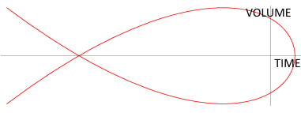
History … vision of future ?
JBM stores it
. Learn from past how to land to INBOX . Study trends to optimize proactivity & anticipate latency of actions
. Easy reporting to your direction
Volume / rate / threshold, per day / week / month
emails, blacklists, complaints, bounces, incidents,…

Slide 5
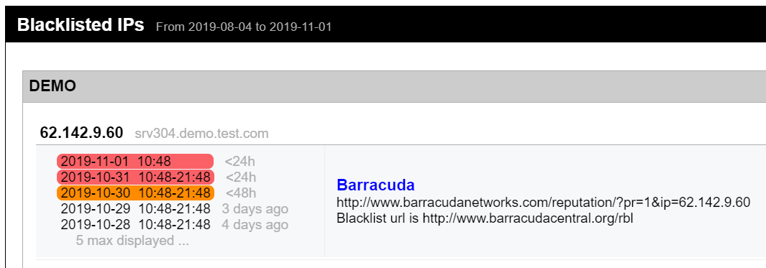
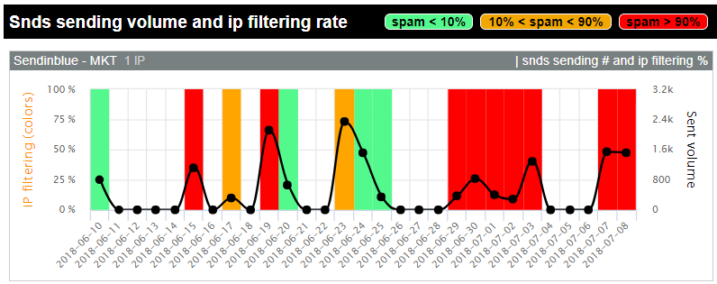
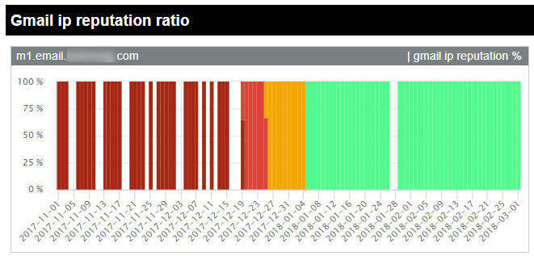
Screenshots / reputation
Get maximum informations about “seen” reputation from all your IPs or group of IPs . Blacklists: IPs/domains . Whitelists . Spamassassin scores . Microsoft reputation
. Gmail reputation (since 2015 vs 2019 for competitors !)
Microsoft: filtering, trap hits, complaints rate
Gmail: domain, IP, spam rate

Slide 6
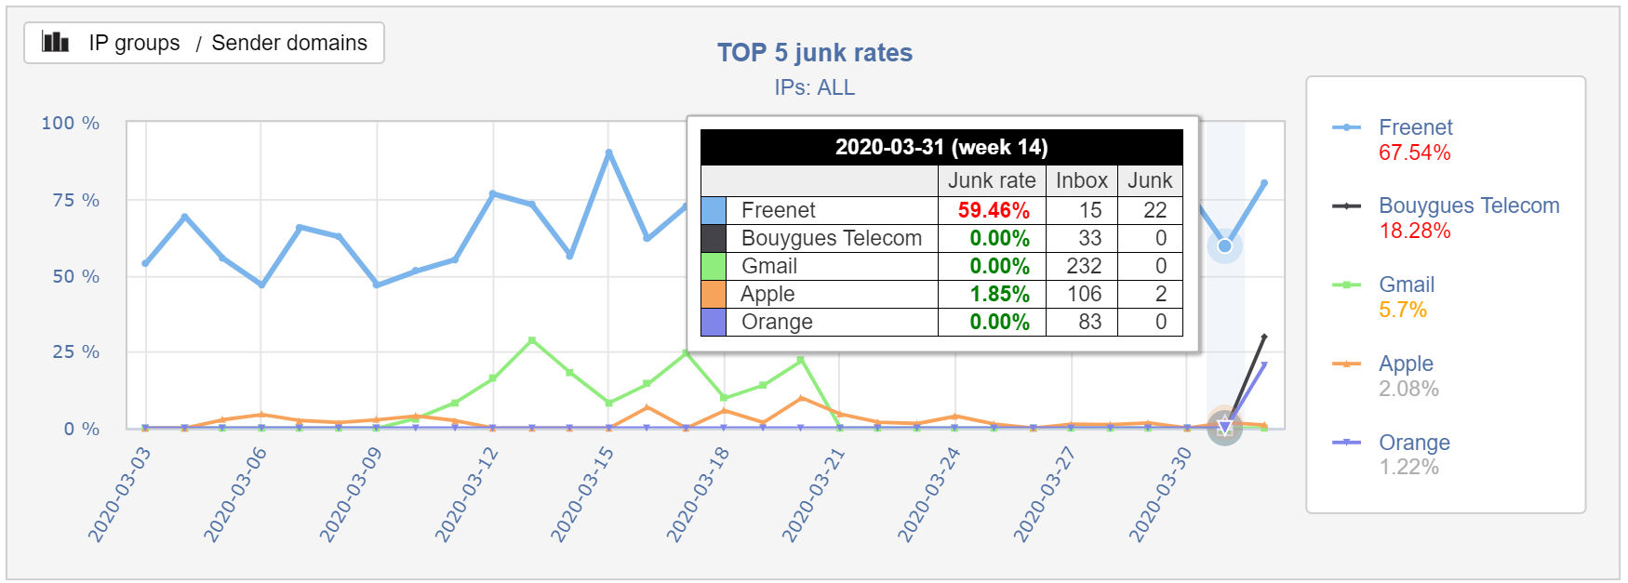
Screenshots / Inbox placement
. A seedlist of more than 200 emails from more than 30 worldwide webmails/ISPs, B2B included . Gmail: tab & important status detection . Highlights on warning (authent, reverse, spamassassin, missing subjects, blacklists…)

Slide 7
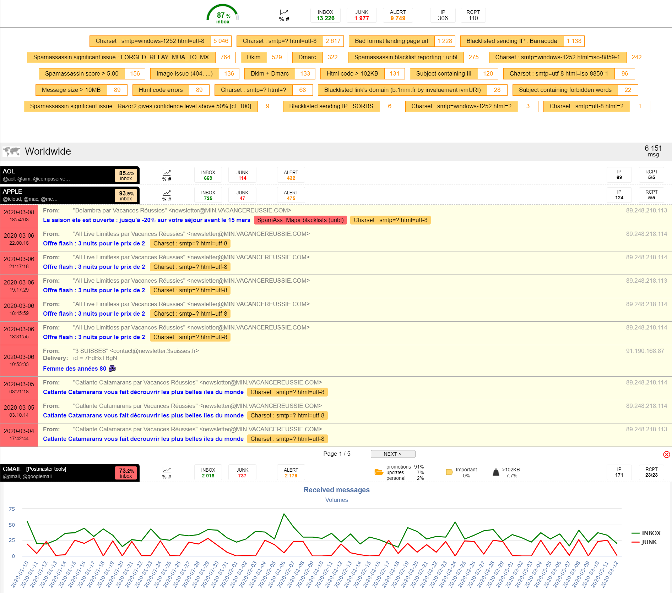
Screenshots / Inbox placement

Slide 8
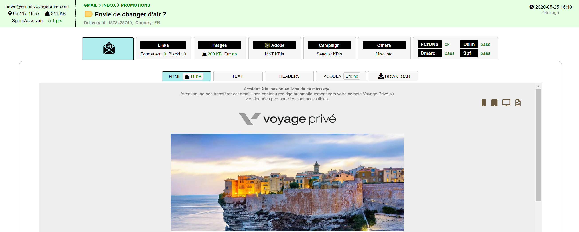
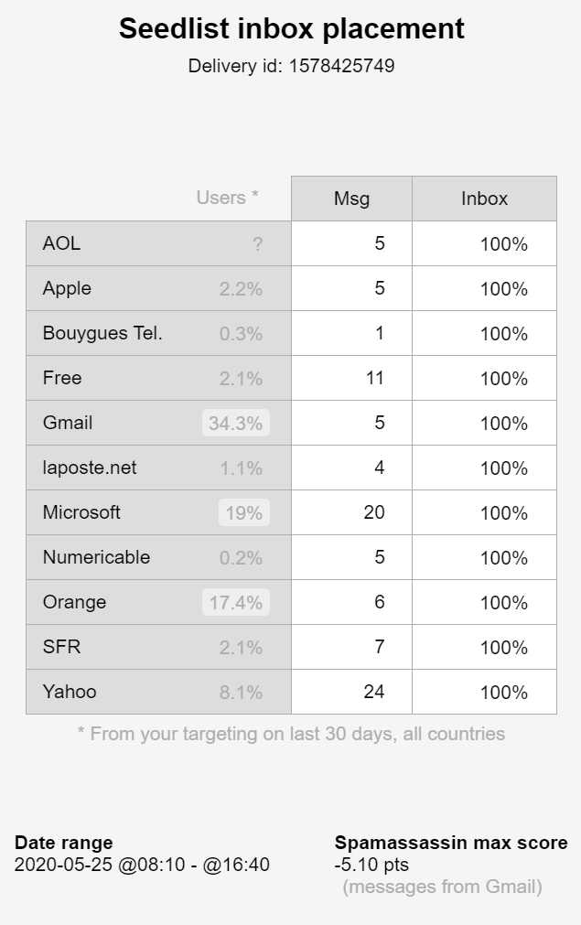
Screenshots / Inbox placement
. Maximum information about received emails (eco system embedded) . Smartphone / tablet preview simulation
. Html code check . Access to full headers . Download messages (for support)

Slide 9
Screenshots / Inbox placement
Full message analysis to identify problems quickly

Slide 10
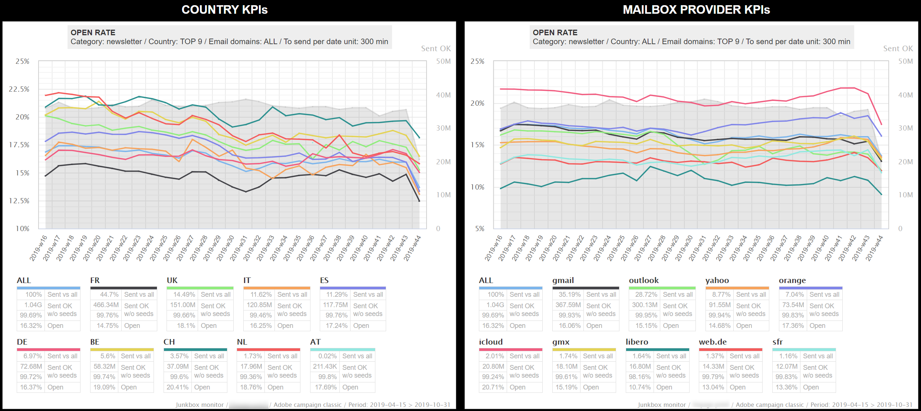
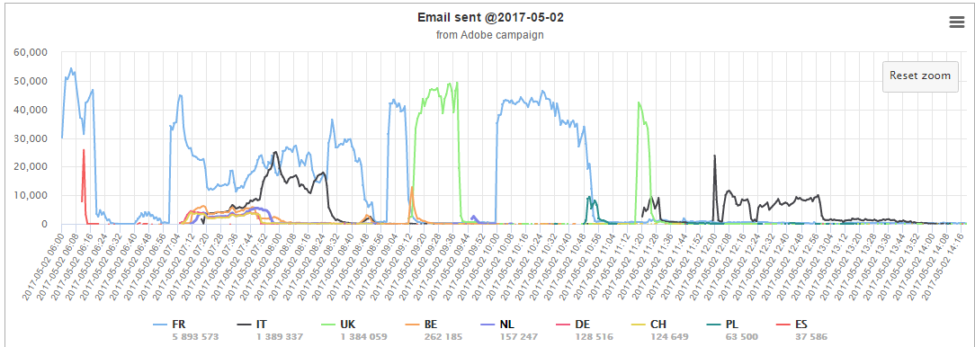
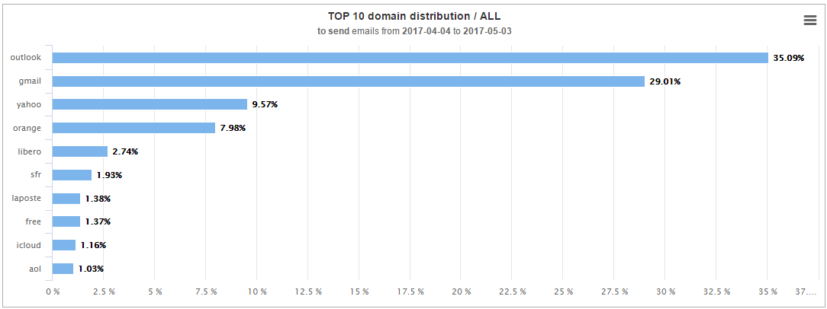
Screenshots / Adobe campaign

Slide 11
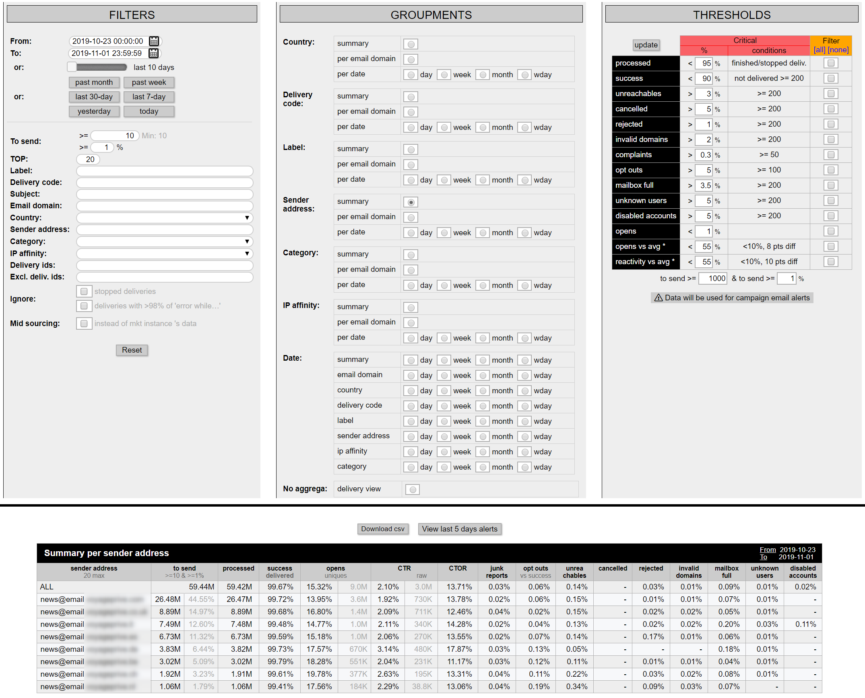
Screenshots / Adobe campaign

Slide 12
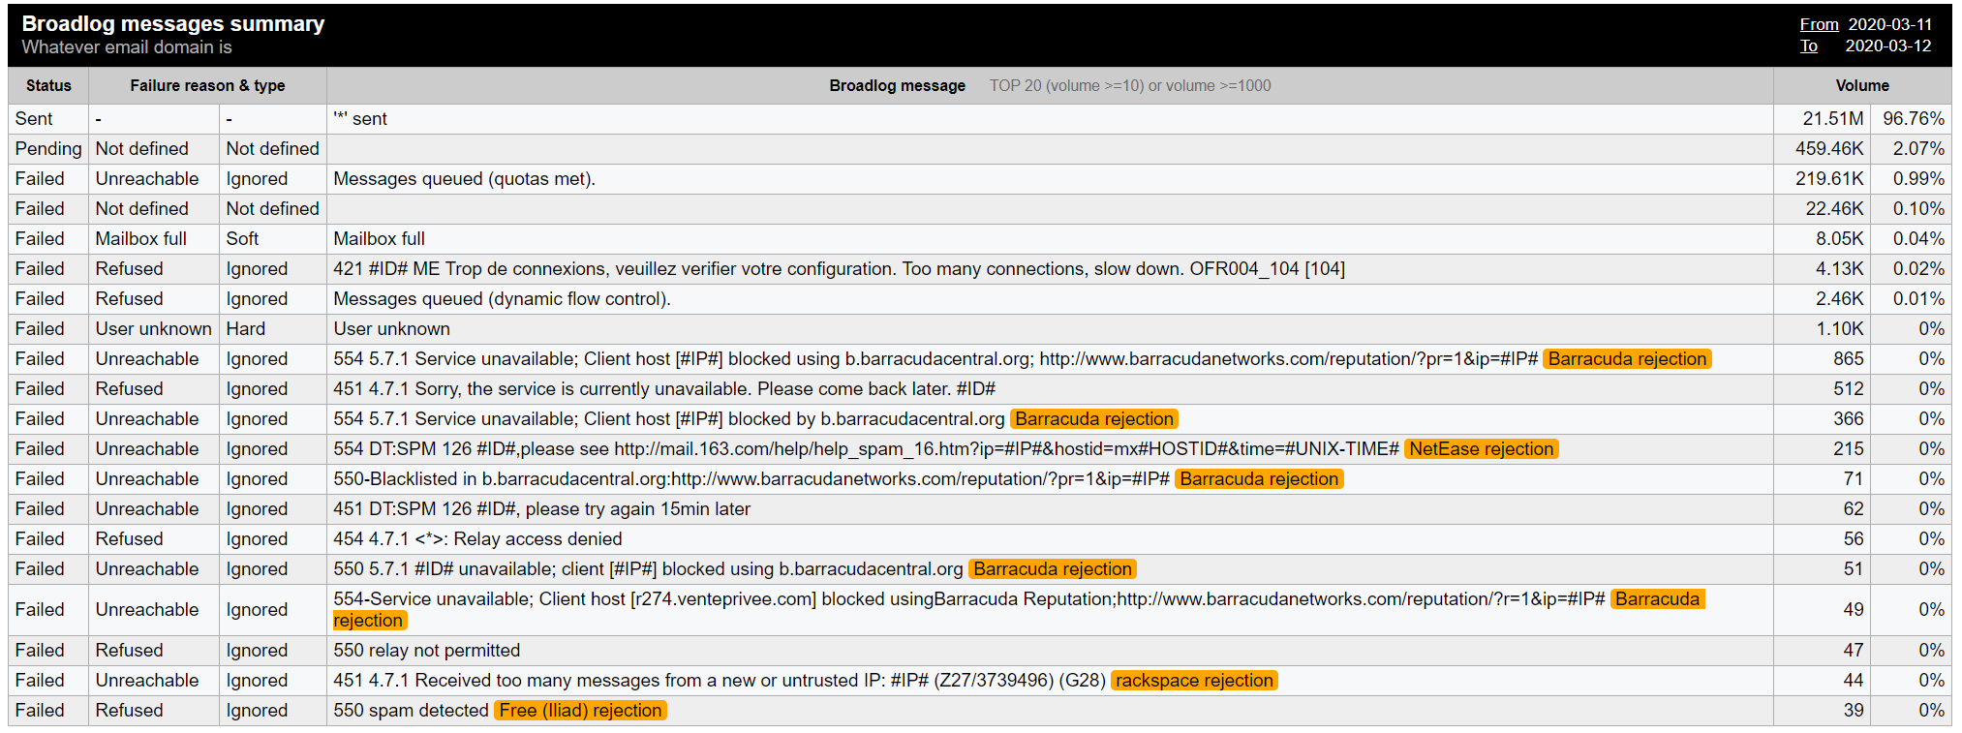
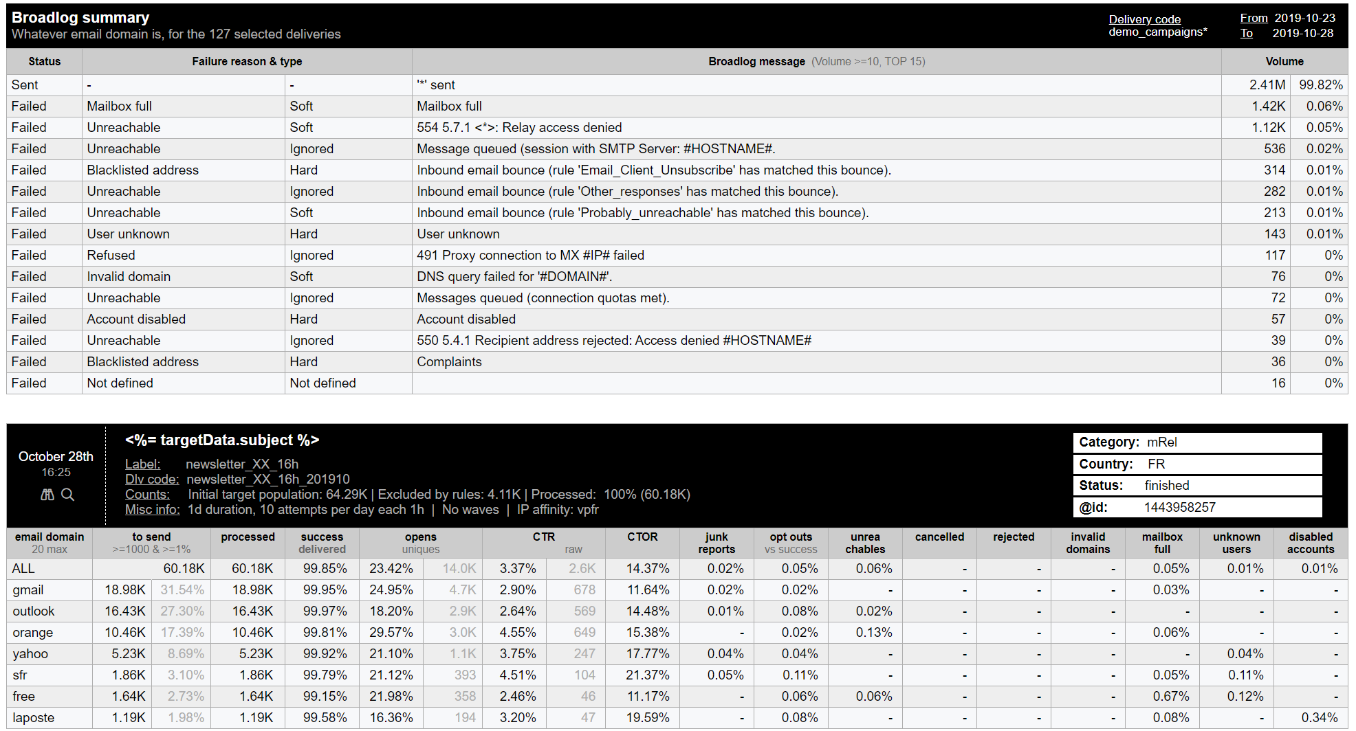
Screenshots / Adobe campaign
Automated alerts base on broadlog content and KPIs reaching thresholds

Slide 13
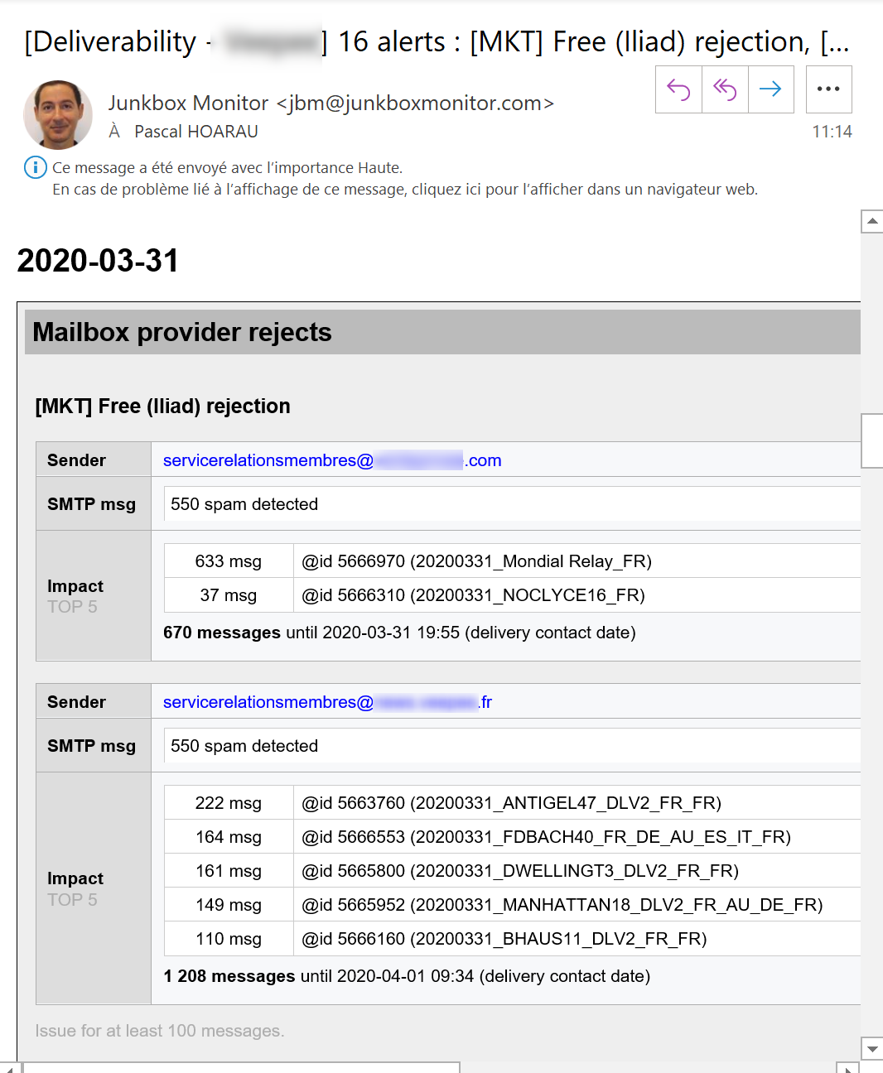
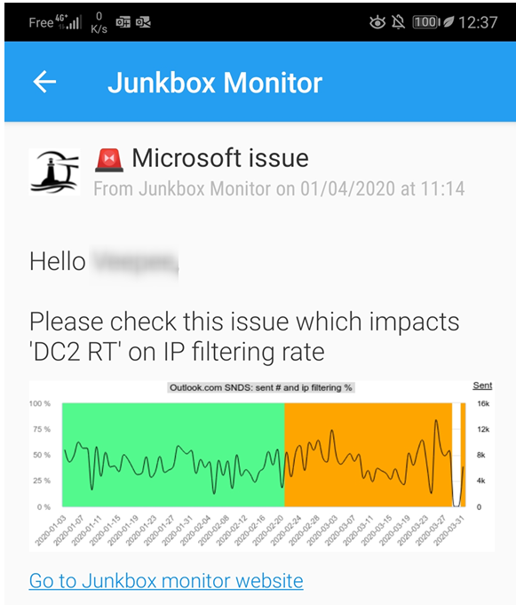
Screenshots / Alerts
emails and push notifications

Slide 14
Data security
Monitored server
Server located on a crash proof datacenter
Https access
Daily encrypted backup on external servers
Up to date operating system & softwares

Slide 15
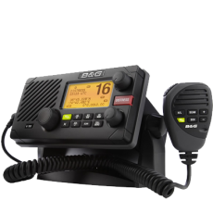
Contact
. Live demo
. POC . General deliverability consulting . Deliverability audit . Technical support with ISP/webmails/ESP . Database quality / content analysis . Monthly monitoring Ours recommendations : . be proactive ! . transmit best pratices to all actors… and verify
Pascal HOARAU
Emailing expert since 1999
for mass mailer companies pascal@halogen-consulting.com
http://www.halogen-consulting.com https://www.linkedin.com/in/pascalhoarau (+33) 06 49 38 71 10

